Slide 1
Heap Sort and Priority Queue
CSE 2215
Instructor : Shekh. Md. Saifur Rahman, Lecturer, Dept. of CSE , UIU

Slide 2
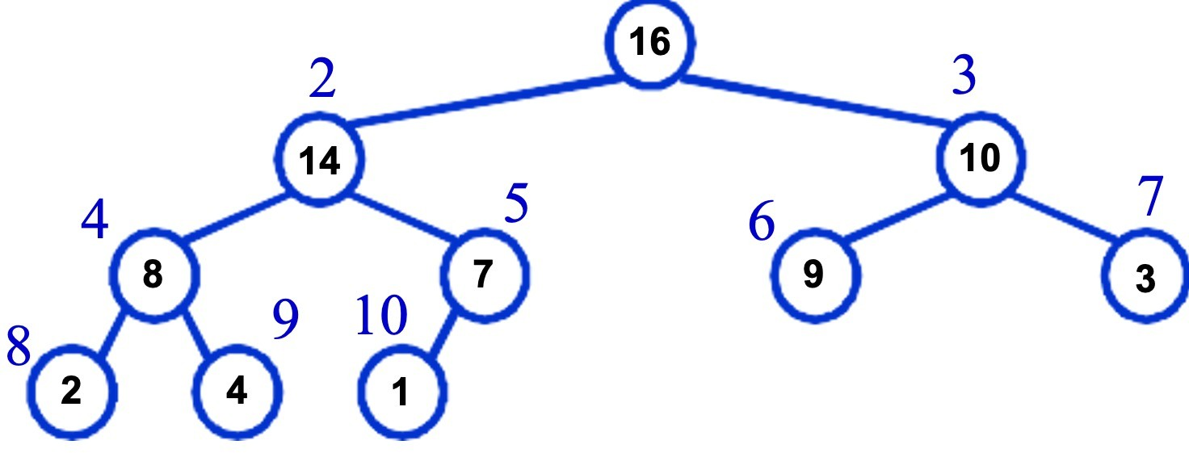

Binary Heaps
The (binary) heap data structure is an array object that can be viewed as a complete binary tree
Each node of the tree corresponds to an element of the array that stores the value in the node.
The tree is completely filled on all levels except possibly the lowest, where it is filled from the left up to a point.
1

Slide 3
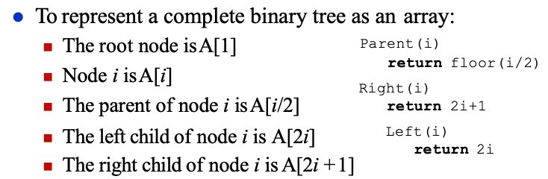
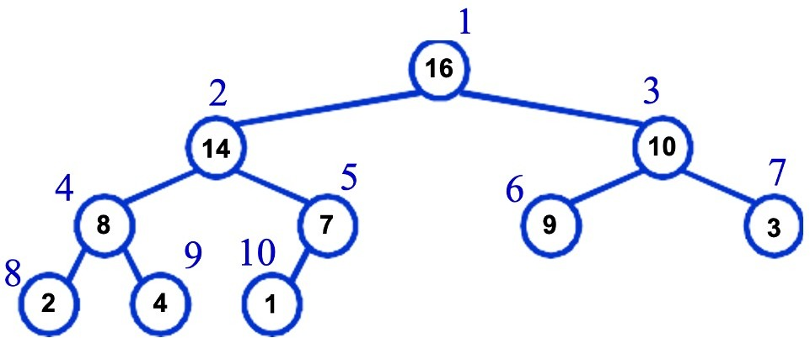
Binary Heaps

Slide 4
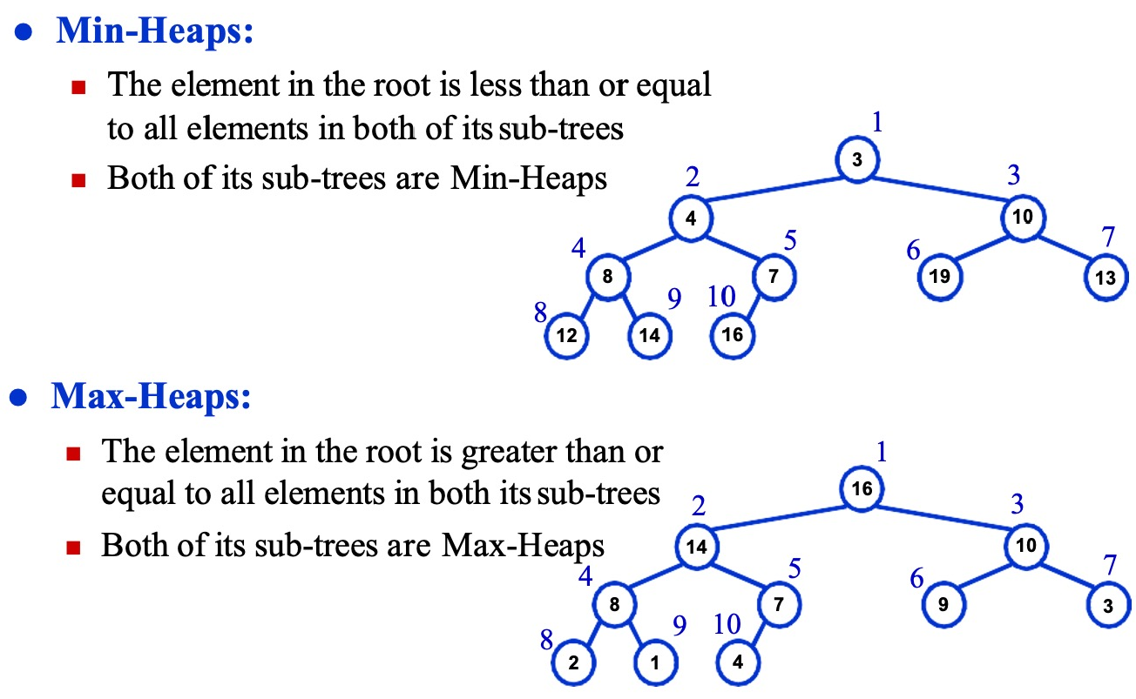
Types of Binary Heaps

Slide 5
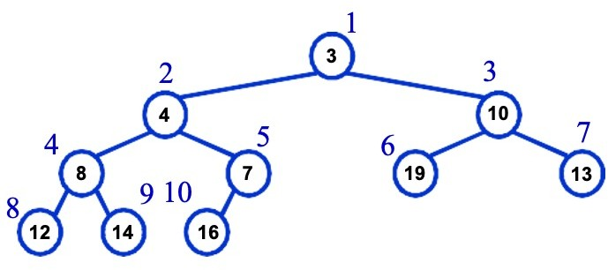
The Min-Heap Property
Min-Heaps satisfy the heap property:
A[Parent(i)] ≤ A[i] ; for all nodes i > 1
The value of a node is at least the value of its parent
The smallest element in a min-heap is stored at the root
Where is the largest element ???
Ans: At one of the leaves [leaf indices are n/2+1 to n]

Slide 6
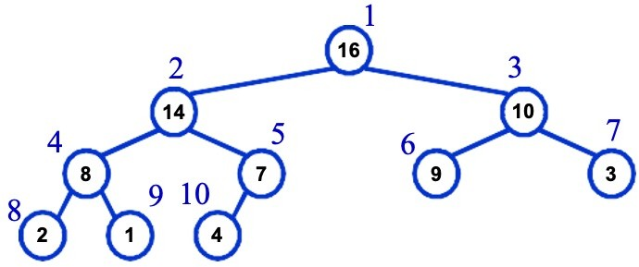
The Max-Heap Property
Max-Heaps satisfy the heap property:
A[Parent(i)] ≥ A[i] ; for all nodes i > 1
The value of a node is at most the value of its parent
The largest element in a max-heap is stored at the root
Where is the smallest element ???
Ans: At one of the leaves [leaf indices are n/2+1 to n]

Slide 7
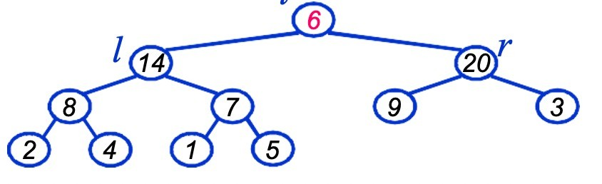
Max-Heap Operations: Max-Heapify()
Max-Heapify(): maintain the max-heap property
Given: a node i in the heap with children l and r
: two subtrees rooted at l and r, assumed to be heaps
Problem: The subtree rooted at i may violate the heap property (How?)
Action: let the value of the parent node “float down” so subtree at i satisfies the heap property
What will be the basic operation between i, l, and r?
i

Slide 8
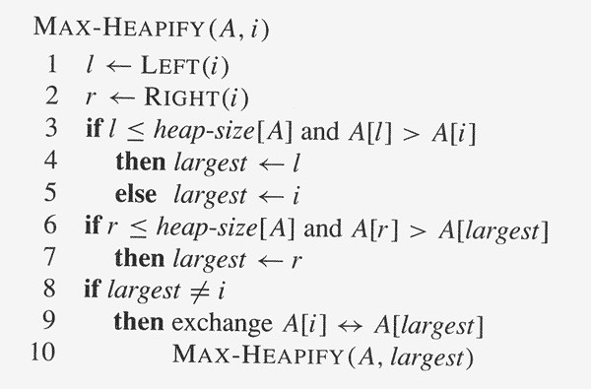
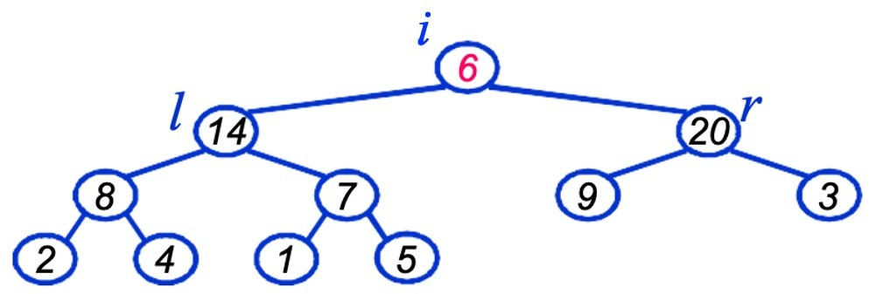
Max-Heap Operations: Max-Heapify()

Slide 9
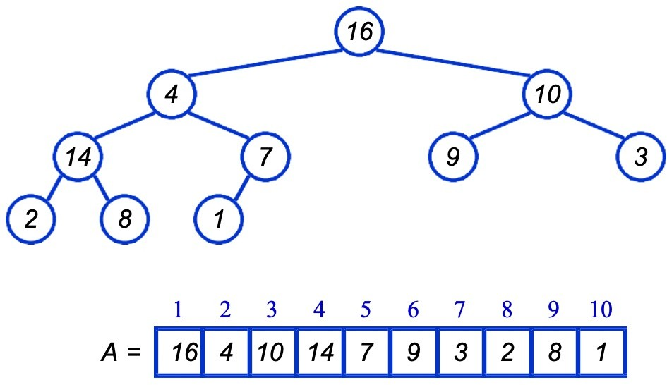
Heapify() - Example

Slide 10
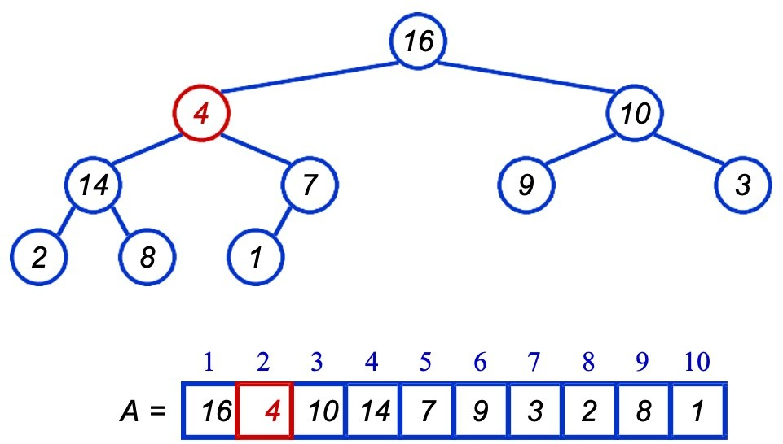
Heapify() - Example

Slide 11
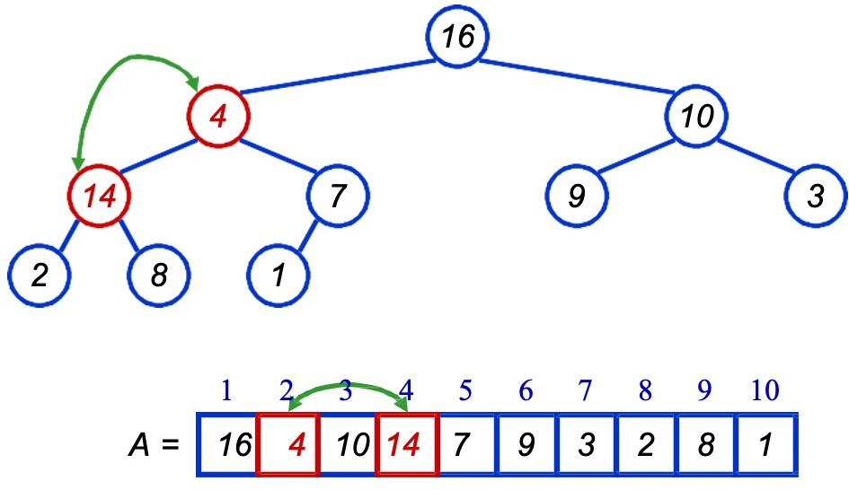
Heapify() - Example

Slide 12
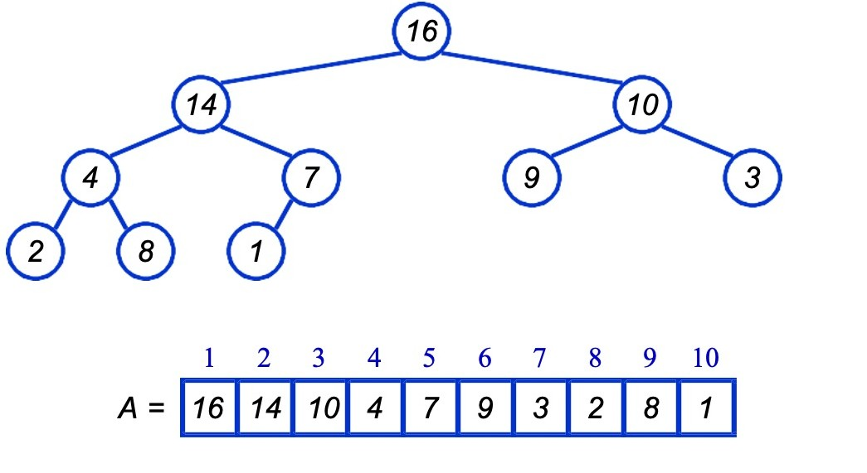
Heapify() - Example

Slide 13
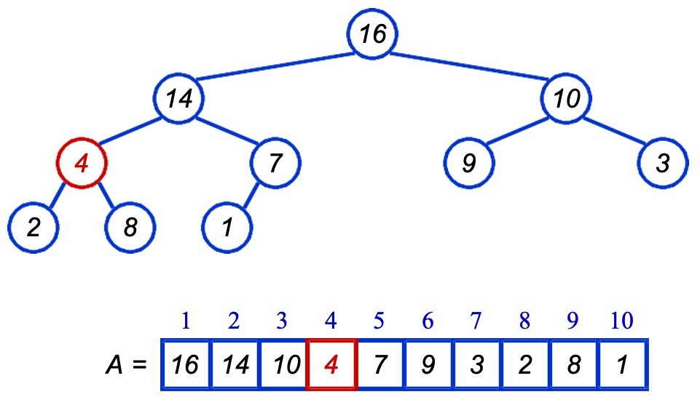
Heapify() - Example

Slide 14
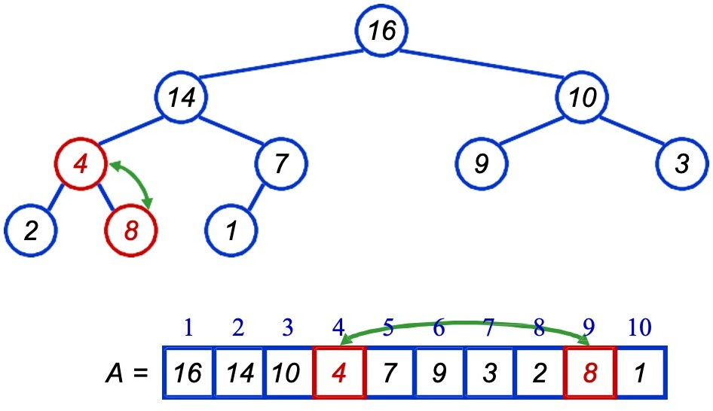
Heapify() - Example

Slide 15
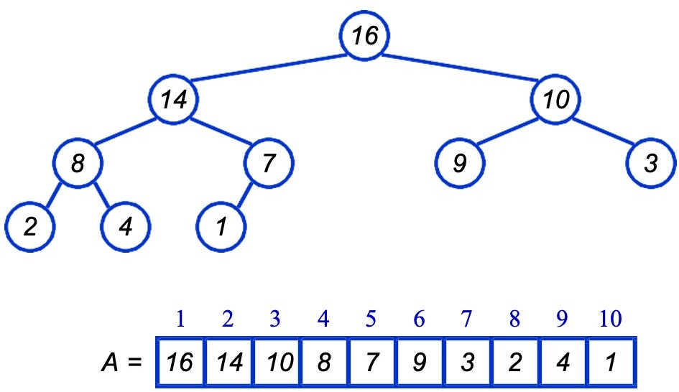
Heapify() - Example

Slide 16
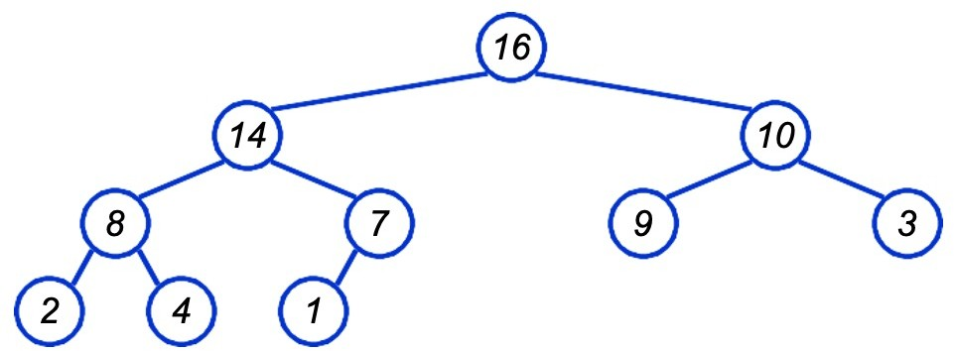
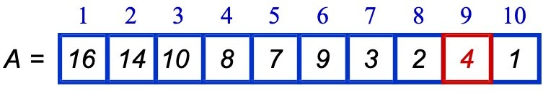
Heapify() - Example

Slide 17
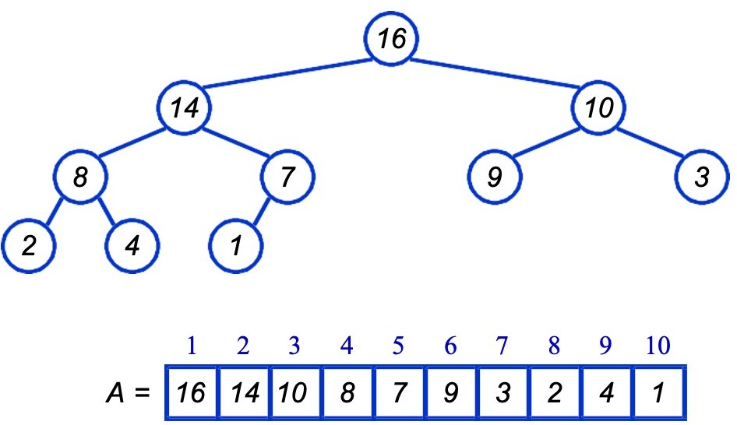
Heapify() - Example

Slide 18
Analyzing Heapify()
Fixing up relationships among the elements A[i], A[l], and A[r] takes O(1) time
If the heap at i has n elements, at most how many elements can the subtrees at l or r have?
Answer: 2n/3 (worst case: bottom row half full)
So time taken by Heapify() is given by
T(n) ≤ T(2n/3) + Θ(1)

Slide 19
Analyzing Heapify()
So we have
T(n) ≤ T(2n/3) + Θ(1)
Solving the recurrence, we have
T(n) = O(log n)
Thus, Heapify() takes O(h) time for a node at height h.

Slide 20
Heap Operations: BuildHeap()
We can build a heap in a bottom-up manner by running Heapify() on successive subarrays
Fact: for array of length n, all elements in the range A[ ⎣n/2⎦ + 1 ... n] already satisfies Heap Property (Why?)
So
Walk backwards through the array from n/2 to 1, calling Heapify() on each node.
Order of processing guarantees that the children of node i are heaps when i is processed

Slide 21
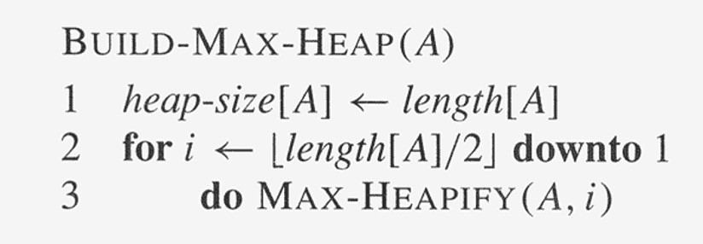
Heap Operations: BuildHeap()
Converts an unorganized array A into a max-heap.

Slide 22
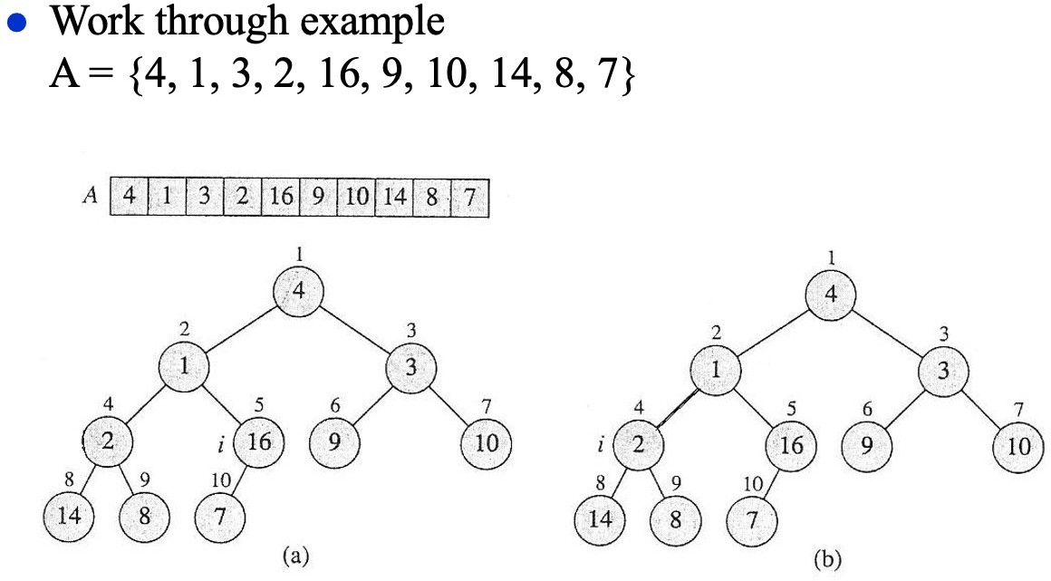
BuildHeap(): Example

Slide 23
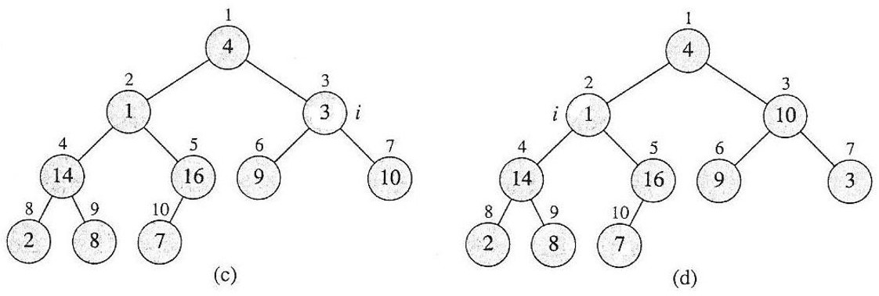
BuildHeap(): Example

Slide 24
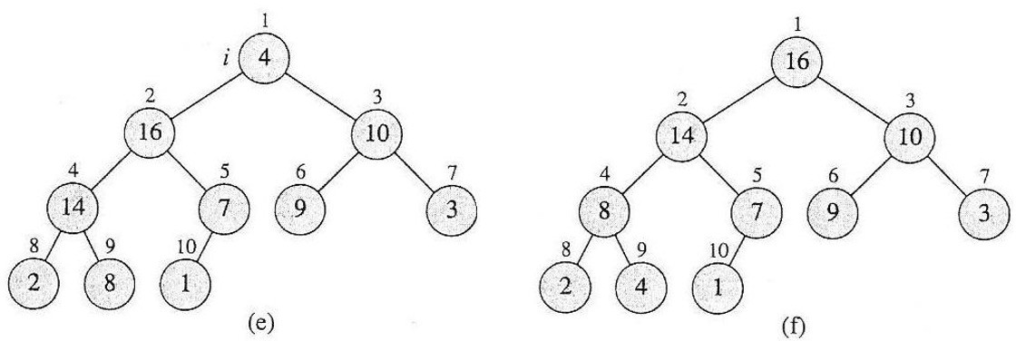
BuildHeap(): Example

Slide 25
BuildHeap(): Example 2
Work through example
A = {14, 11, 33, 22, 56, 49, 30, 24, 18, 37}
Construct a Min-Heap from the given array using Build-Heap function.

Slide 26
Analyzing BuildHeap()
Each call to Heapify() takes O(log n) time
There are O(n) such calls (specifically, ⎣n/2⎦ )
Thus the running time is O(n log n)
Is this a correct asymptotic upper bound?
Is this an asymptotically tight bound?
A tighter bound is O(n)
How can this be? Is there a flaw in the above reasoning?

Slide 27
Analyzing BuildHeap(): Tight
To Heapify() a subtree takes O(h) time, where h is the height of the subtree
h = O(log m), m = # nodes in the subtree
The height of most subtrees is small
Fact: an n-element heap has at most ⎡n/2^{h+1}⎤ nodes of height h
Prove that BuildHeap() takes O(n) time

Slide 28
HeapSort
Given BuildHeap(), a sorting algorithm can easily be constructed:
Maximum element is at A[1]
Discard by swapping with element at A[n]
Decrement heap_size[A]
A[n] now contains correct value
Restore heap property at A[1] by calling Heapify()
Repeat, always swapping A[1] for A[heap_size(A)]

Slide 29
HeapSort
Heapsort(A)
{
BuildHeap(A);
for (i = length(A) downto 2)
{
Swap(A[1], A[i]);
heap_size(A) = heap_size(A) - 1;
Heapify(A, 1);
}
}

Slide 30
HeapSort
Work through example
A = {14, 11, 33, 22, 56, 49, 30, 24, 18, 37}

Slide 31
Analyzing HeapSort
The call to BuildHeap() takes O(n) time
Each of the (n – 1) calls to Heapify() takes O(log n) time
Thus the total time taken by HeapSort()
= O(n) + (n - 1) O(log n)
= O(n) + O(n log n)
= O(n log n)

Slide 32
Priority Queue
A queue that is ordered according to some priority value
The heap data structure is incredibly useful for implementing priority queues
A data structure for maintaining a set S of elements, each with an associated value or key
Supports the operations Insert(), Maximum(), and ExtractMax()

Slide 33
Priority Queue Operations
Insert( S, x ) – Inserts element x into set S, according to its priority
Maximum( S ) – Returns, but does not remove, the element of S with the largest key
Extract-Max( S ) – Removes and returns the element of S with the largest key
Increase-Key( S, x, k ) – Increases the value of element x’s key to the new value k
How could we implement these operations using a heap?

Slide 34
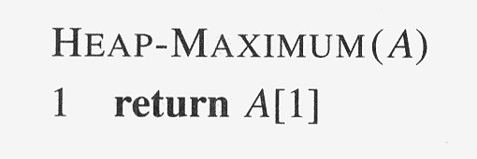
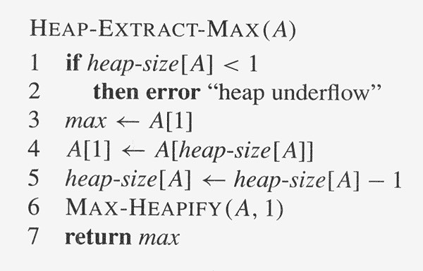
Priority Queue Operations

Slide 35
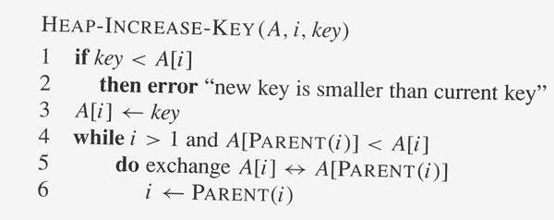
Priority Queue Operations

Slide 36
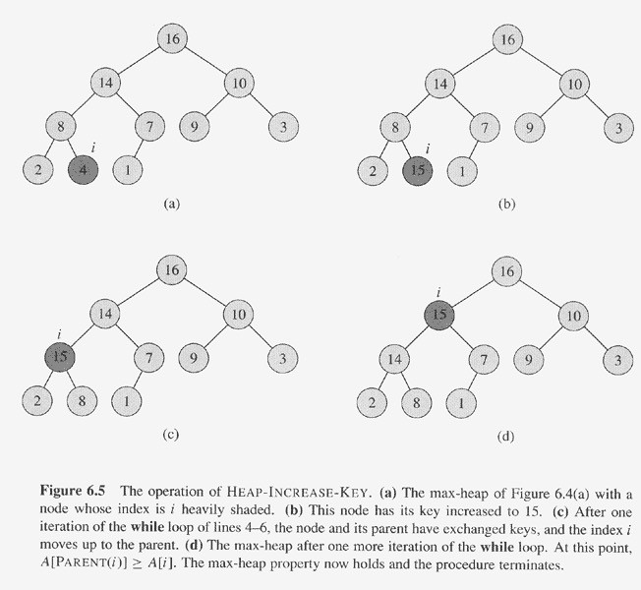
Priority Queue Operations

Slide 37
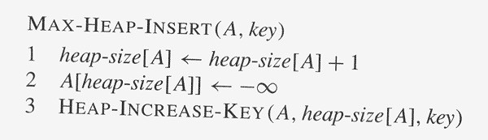
Priority Queue Operations

Slide 38
Thank You

